Slide 1

Android Lesson 1: How To Android
By: Josh Chang
Notes:
Introduce yourself
Ask who has experience

Slide 2
What Will We Learn?
Week 2: How to create a basic app
Week 3: Intents how to go to different pages
Week 4: ActionBar to go to different pages
Week 5: How to debug: Log.d, Toast and music!
Week 6: BREAK
Week 7: DB 1
Week 8: DB 2
Week 9: Interacting with online servers
Week 10: BREAK

Slide 3


What Do You Want to build?
Notes:
Name
How much experience do you have in programming
What you want to learn from the class

Slide 4
About Android
It is (partially) Event Driven Programming
Too many things to learn: only pick and choose some important things for this class

Slide 5


Let’s Create Our First Project!
Notes:
Pull out Android Studio and start a new project

Slide 6
New Project Notes
Company Domain – Unique identifier for the play store. You don’t need to own the domain
Minimum SDK – The minimum version your phone can support. Google updates it everyday. Recommended min: 16
http://developer.android.com/about/dashboards/index.html
Activity – The Java file where you put your code that allows you to control your layout and create your own functionality
Layout – The XML file where you create the appearance of the app

Slide 7
Android Studio File Structures (Part 1)
manifests – Contains AndroidManifest.xml which is your settings. Includes: devices permissions, sdk, global style setting
java – Contains two folders. One is your actual code and the other is test code
Res – Resources. Put all of your assets in here

Slide 8
Android Studio File Structures (Part 2)
res – Resources. Put all of your assets in here
drawable – where you put your images
layout – where you put your xml files that define how your activity will look
mipmap – where you put small images, specifically icons
values – defined variables that you can call anywhere. Handy if you have a large code base
colors.xml –user defined global variables for color
strings.xml – user defined global variables for string. Useful for multi-language
Styles.xml – user defined global variable for layout styles.

Slide 9
Linear Layout Vs. Relative Layout
Layout components are used to store widgets inside of them. The 2 most common ones are:
Relative Layout – The widget’s location can be placed anywhere inside the layout as you wish, relative to other objects
Linear Layout – The widget’s position will always be forced to be adjacent with each other

Slide 10
Important Component Properties
layout_height and layout_width – assigns the height and width. Use:
match_parent to expand to the outer layer (the device size, the layout a widget is in)
wrap_content to expand to the minimum of how big your widget would be
Enter a specific dp (dimension pixel)
id=“@+id/”- create an id that would be used to identify your widgets
layout_margin<direction> - Moves your widget in <direction> in dp
layout_padding<direction> - As oppose to moving your widget, you add “padding” space for contents of the widget
text – Sets text to appear on your widgets

Slide 11
Important Relative Layout Properties
You can use these in anything that’s inside a Relative Layout:
Layout_above, layout_above, layout_alignRight, layout_alignLeft: give an id of a widget and you’ll move the current widget next to the other widget

Slide 12
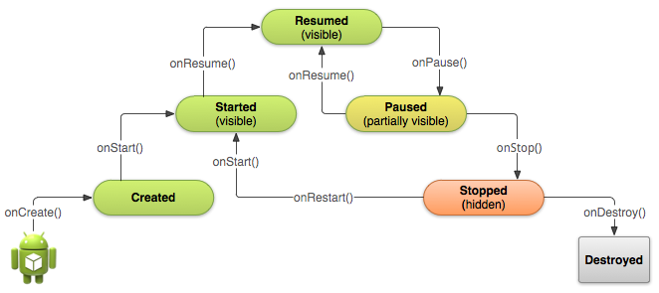
Android Life Cycle

Slide 13
How To Access Your Layouts
Two things that needs to be done
1. setContentView(R.layout.<layout_name>);
2. findViewById(R.id.<id of your widget>);
Note: R is a shortcut to your res folder.

Slide 14
Important TextView Methods
setText(“text”); – Sets your label to have the text inside. Usually labels are just there to display information.

Slide 15
Important EditText Methods
getText().toString() – getText() returns an Editable class that is your text, just convert it to a String to get the value
setText(“text”) – Change the text of your EditText widget.

Slide 16
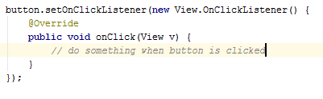
Important Button Methods
Adding a listener:

Slide 17
Questions?

Slide 18
Group Work Time!
1) Create a Mad Lib game where you use 2 Edit Texts to complete the sentence:
“Yesterday I went to ______ and I ______“
2) Create a new reset button that would clear your Text View and your Edit Text
3) Add a new Text View and a new button that will use the same texts for a new Mad Lib in the new Text View:
“I want to learn ______ and ______ in class!”

